Slide 1
Metaverse Presentation
Name: Khuram hanif Center: Air University
Roll No: PIAIC69976 City: Islamabad
Days / Time: Saturday - 02:00 PM To 06:00 PM
Batch 40

Slide 2
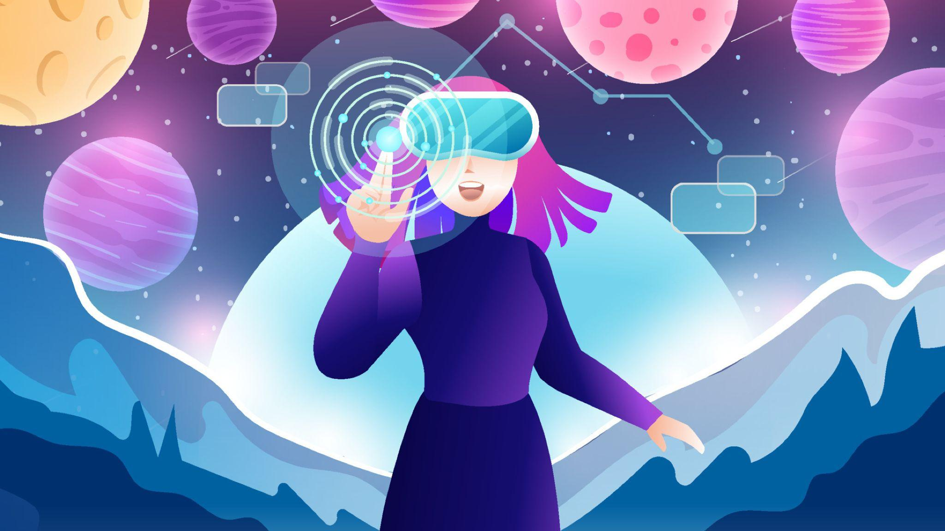
What is METAVERSE
In futurism and science fiction, the metaverse is a hypothetical iteration of the Internet as a single, universal and immersive virtual world that is facilitated by the use of virtual reality (VR) and augmented reality (AR) headsets. In colloquial use, a metaverse is a network of 3D virtual worlds focused on social connection.

Slide 3
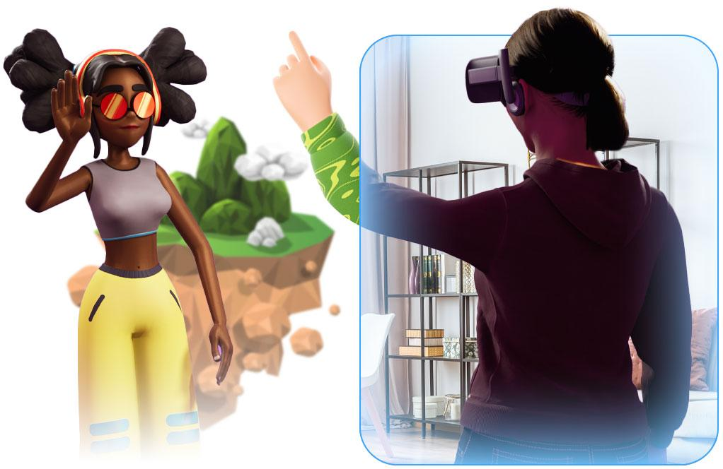
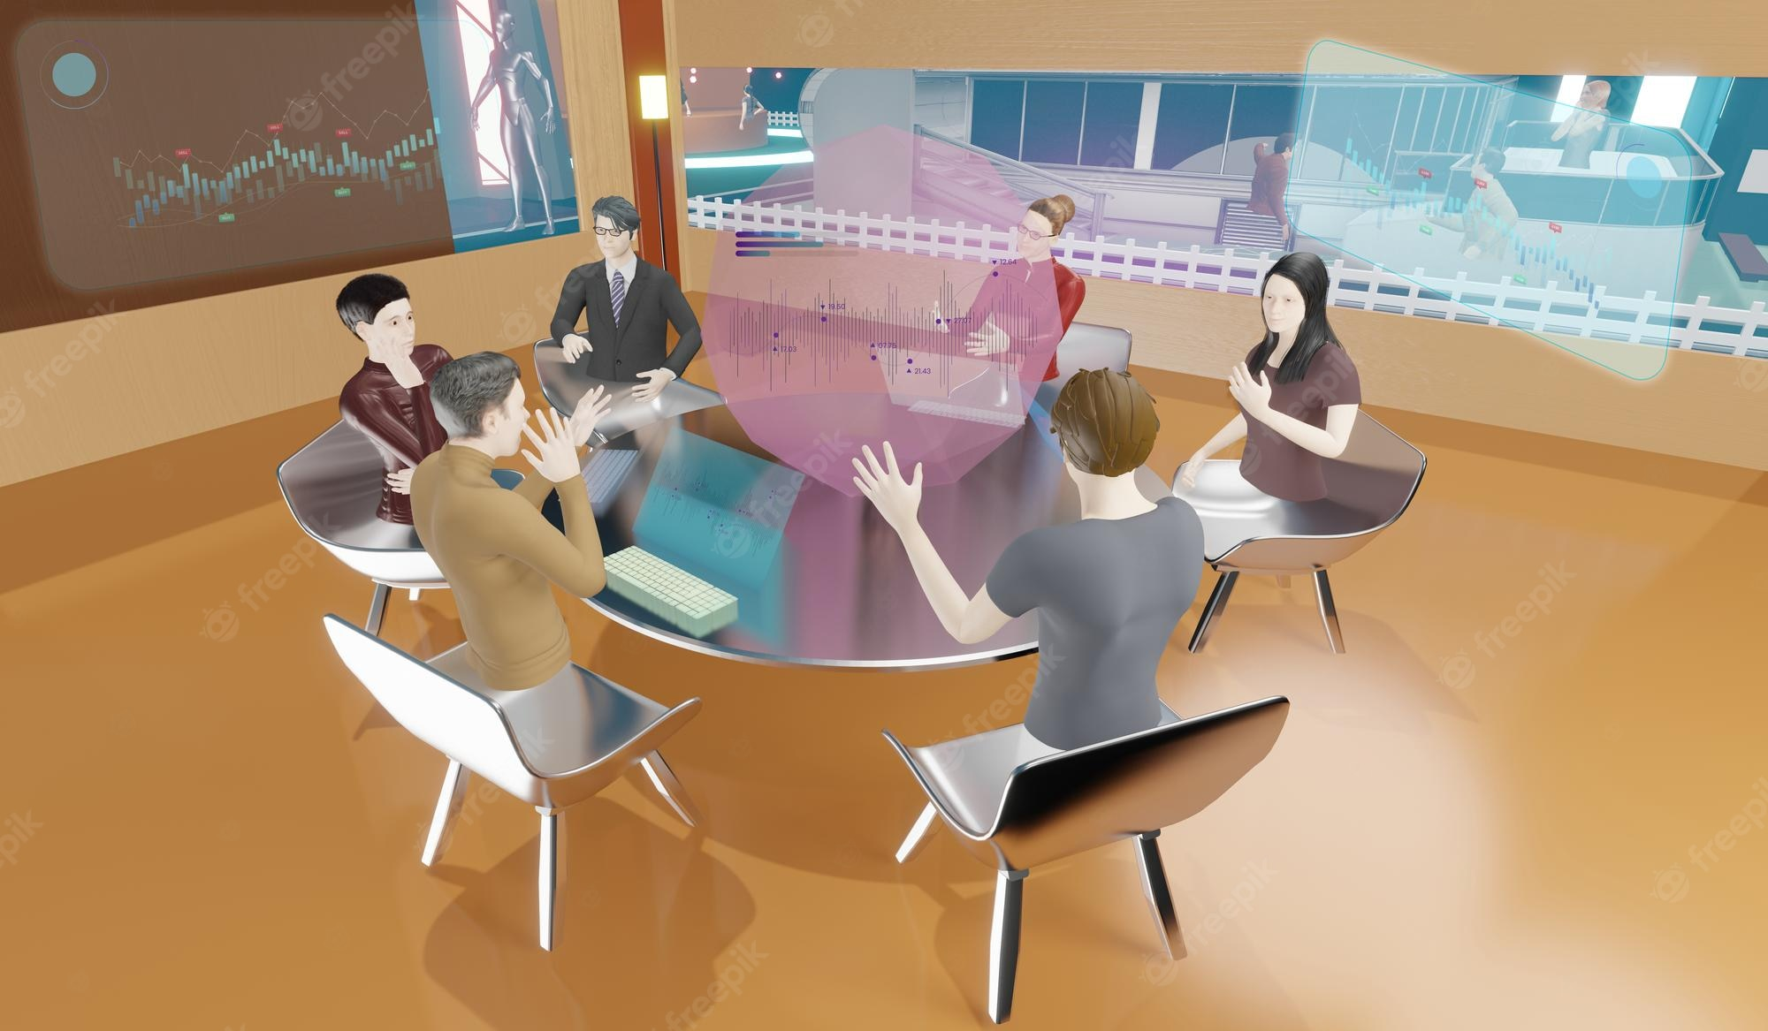
What does Metaverse do?
What does the metaverse do?
“The term Metaverse is used to describe a combination of the virtual reality and mixed reality worlds accessed through a browser or headset, which allows people to have real time interactions and experiences across distance.”

Slide 4
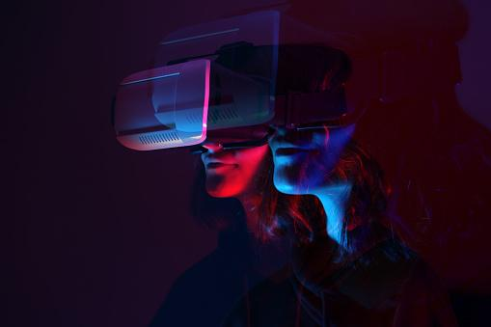
Origins of Metaverse
The term "metaverse" originated in the 1992 science fiction novel Snow Crash, as a portmanteau of "meta" and "universe". Metaverse development is often linked to advancing virtual reality technology due to increasing demands for immersion.Recent interest in metaverse development is influenced by Web3, a concept for a decentralized iteration of the internet. Web3 and the Metaverse have been used as buzzwords to exaggerate development progress of various related technologies and projects for public relations purposes.Information privacy, user addiction, and user safety are concerns within the metaverse, stemming from challenges facing the social media and video game industries as a whole.

Slide 5
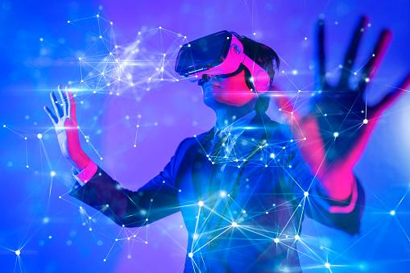
What you can do in a metaverse?
Make a virtual property
Earn money by investing in NFTs, playing games that earn you money,etc.
Advertise anything
Create an environment customized to yourself
Own digital properties
Buy and sell unique assets
Express yourself through customizable avatars
Socialize and make new friends
Shop for real and virtual products
Attend concerts, trade shows, and learning events
Get a job in the metaverse
(Everything you want)

Slide 6
What are some examples of it?
Meta:
The tech giant formerly known as Facebook has already made significant investments in virtual reality. Meta envisions a virtual world where digital avatars connect through work, travel or entertainment using VR headsets.
Microsoft:
The software giant already uses holograms and is developing mixed and extended reality (XR) applications with its Microsoft Mesh platform, which combine the real world with augmented reality and virtual reality. In March 2022, Microsoft showed off its plans for bringing mixed-reality including holograms and virtual avatars to Microsoft Teams in 2022.

Slide 7
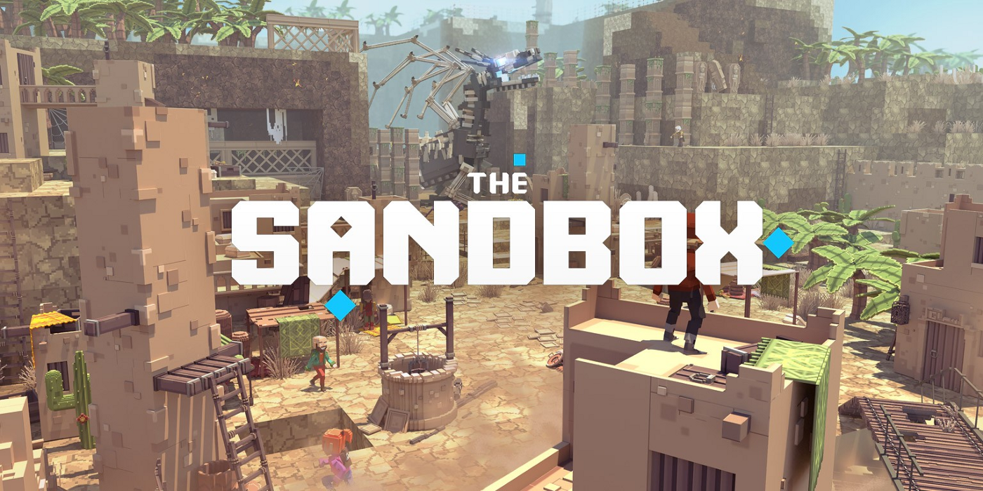
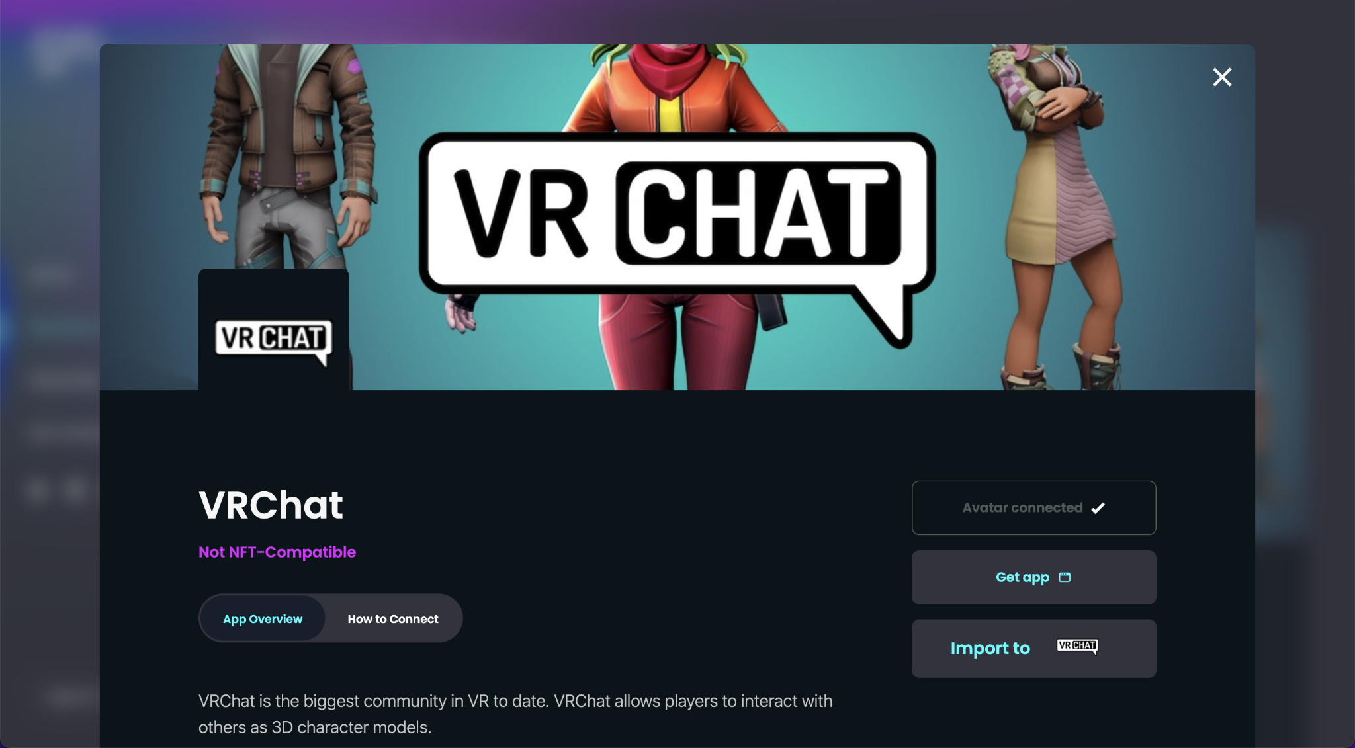
Epic Games:
The company that developed Fortnite, has said, "It's no secret that Epic is invested in building the metaverse." It's held concerts by the likes of Ariana Grande and Travis Scott, movie trailers and music.
Real gear in a virtual world:
Fortnite partners with Balenciaga on outfits for you and your avatar.
Vr chat:
Vrchat is a game and it is a good example of how a metaverse may look like.

Slide 8
Some Predictions for How the Metaverse Will Impact Our Lives
We will begin to express ourselves in new and exciting ways: Every person will have a character that represents themselves in the Metaverse called an avatar. We will learn how to express pieces of ourselves through these avatars in ways that we may not have been able to test out before.
Our mental health will be impacted: This could have both a positive and a negative impact on our mental health as we are living in two worlds. As with any new technology, we will need to be mindful about not disconnecting ourselves so much from our real life that it becomes difficult to navigate them at the same time.

Slide 9
We may experience dissonance between reality and the metaverse:
Let's face it, living in a world where I can have whatever I want, whenever I want it sounds like a dream. But it will also come with some downsides. Going from a Metaverse built around a real-time experience and then going back into reality where things tend to manifest slower will be a bit of a shock to the system. So much so that it could lead to people disconnecting from their real life in favor of the world they've created in the Metaverse. Or it could simply be disorienting to bounce back and forth between the two experiences. We are going to have to learn how to navigate both worlds at the same time.
We will create our collaborative work environment:
Work environments will take on a whole new meaning in the metaverse. There will be no limit to the environments we can create. There will be no barriers between environments as we can simply shift between them.

Slide 10
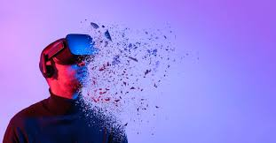
Pros of Metaverse:
Traveling the world without moving
Increasing technological literacy and skills
Connecting with new people without feeling awkward
Creating completely new job opportunities
Cons of Metaverse:
Required of Advanced Digital Technologies
Privacy and Security Implications
Reducing the Difference between Real and Virtual

Slide 11
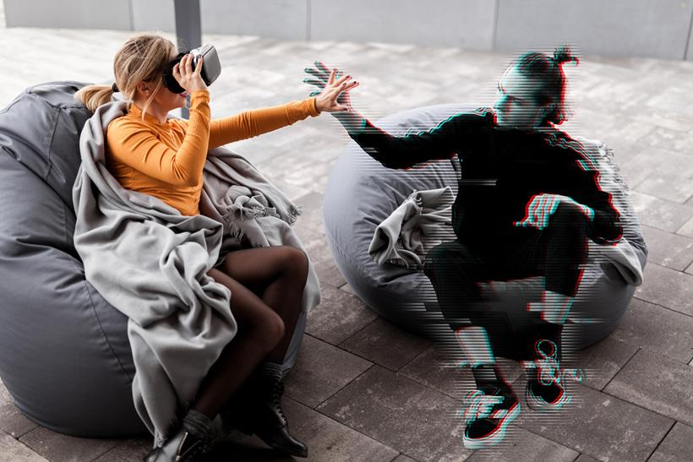
Future Of Metaverse
Today's metaverse: virtual reality as the "digital escape".Over the next few years the future metaverse would be something very similar to our real world in many aspects and even replace some real-world activities (like working or hanging out).
"A lot of people think that virtual reality is an illusion, that it's not real. But I say that it has causal power, it exists outside of our mind, and is not an illusion."

Slide 12
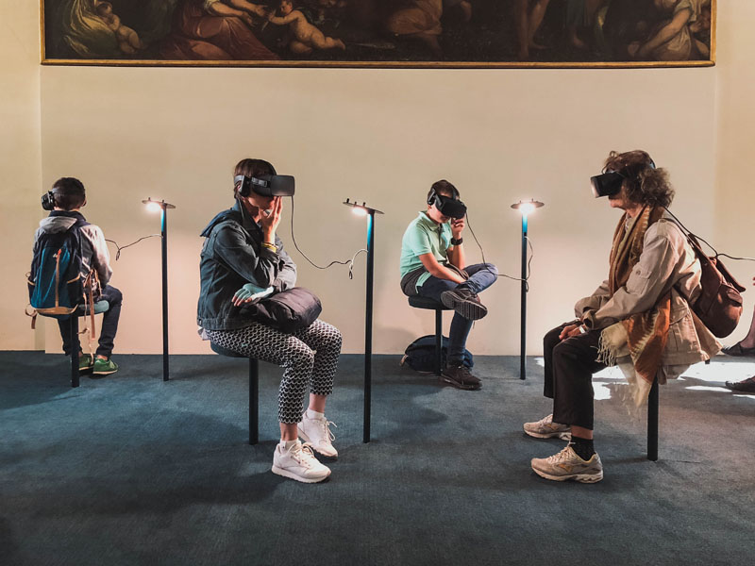
Will virtual reality/AR help improve our imagination and increase our creativity, or just make us more addicted to screens?
The concept of VR headset is very good as it allows you to experience virtual reality in a better way.
But this is a very unhealthy practice. 1st of all it damages our eyes alot. Secondly it is just promoting more and more isolation of a person and allows him to enter or fantasize about a world which does not exist. It will not be a bad thing if we use it occasionally but

Slide 13
